Slide 1
Optical Character Recognition (OCR) with Python
Present By-Pritiranjan Biswal

Slide 2
What is OCR?
Definition: Optical Character Recognition
Converting Image text to Digital text
Applications: Digitizing documents, automating workflows, accessibility tools
Why use OCR with Python?
Powerful programming language
Open-source libraries and tools
Scalability and automation

Slide 3
Popular OCR Libraries for Python:
Tesseract: Open-source OCR engine, accurate for high-quality images.
pytesseract: Python wrapper for Tesseract, easy to use.
EasyOCR: Lightweight and fast OCR library, supports multiple languages.
Nanonets: Cloud-based OCR API, handles complex images and layouts.

Slide 4
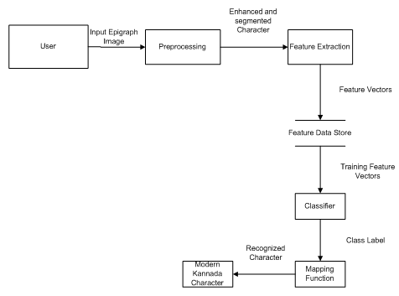
Architecture of ocr
So, from the diagram, we can summarize the steps in the following way:
First the user gives an image or other format as the input.
Next the image is preprocessed and it is converted into the format such that the model can work or recognition.
Next, the model does the work of feature extraction. This is a very essential step as the recognition is based on the efficiency of features extraction and preservation.
Next the features extracted are stored in a proper way.
After this the classifier/model works in recognition part. The mapping function is applied after the classifier.
Finally, the recognized output is displayed or processed for further needs.

Slide 5
OCR with Tesseract and Pytesseract:
Installation and Setup
Install Tesseract engine and pytesseract library
Basic Code Example
Load image with cv2 or PIL
Apply pre-processing steps (deskewing, binarization)
Use pytesseract.image_to_string() to extract text
Print or store extracted text

Slide 6
Advanced OCR Techniques:
Pre-processing: Binarization, noise reduction, skewing correction
Post-processing: Spelling correction, confidence scores, layout analysis
Handling complex images: Multi-column layouts, handwritten text, colored backgrounds
Integrating with other libraries: OpenCV for image manipulation, Tesseracrt configurations

Slide 7
Real-World Applications of OCR:
Extracting text from scanned documents
Automating data entry from invoices, receipts, forms
Creating searchable PDFs from scanned documents
Building document analysis and summarization tools
Accessibility applications for visually impaired users
Resources and Next Steps:
List of Python OCR libraries and documentation
Online tutorials and code examples
Community forums and discussion groups
Ideas for further exploration and project ideas

Slide 8
Thank you

